Slide 1

Canadian Employment Dashboard A Django-Based Data Visualization Application
CPRO 2201 – Python Programming II
Winter 2026, Red Deer Polytechnic
Nikita(000370801)
Raman(000377207)
Taran(000376496)
Submission Date: April 19, 2026
Github Repository
https://github.com/nlnu499/canadian_employment

Slide 2
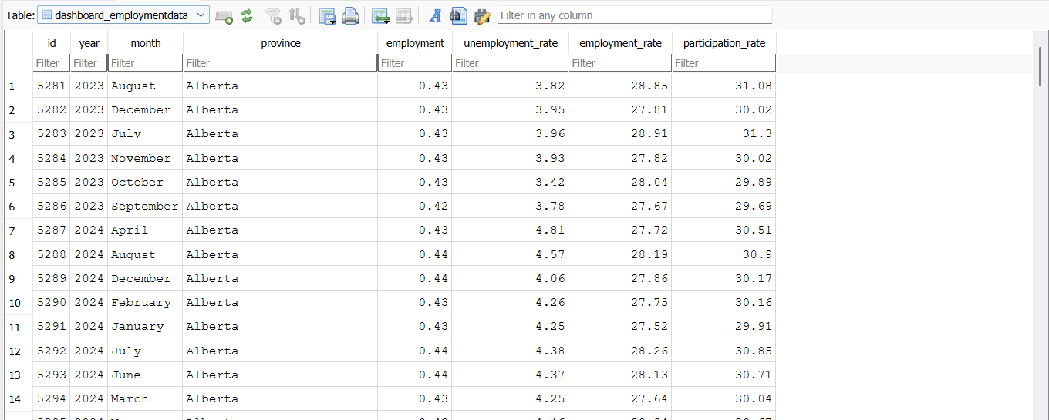
Data Source
Project Overview:
Web application to analyze employment data
Uses Canadian dataset
Converts CSV → Database
Includes:
Employment data
Province-wise statistics
Yearly trends

Slide 3
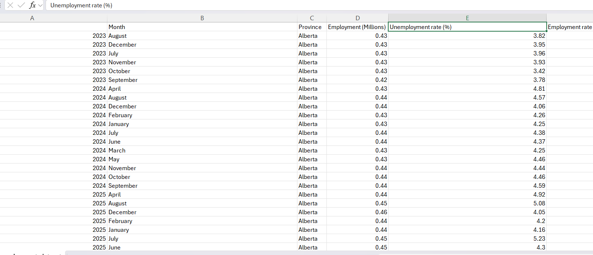
Data Source (Database Conversion)
• Dataset loaded from CSV file
• Contains employment data for provinces
• Includes year, month, employment values
• Data converted into structured database
• Each row stored as a record
• Django models used for storage

Slide 4
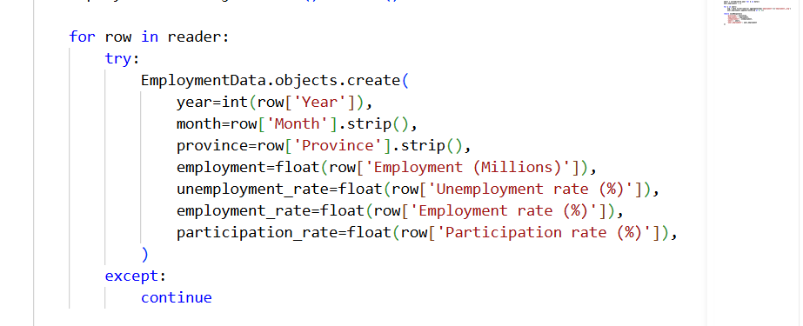
Data Processing
• Removed invalid or missing data
• Cleaned text using .strip()
• Converted values using int() and float()
• Ensured correct data format
• Stored cleaned data in database

Slide 5
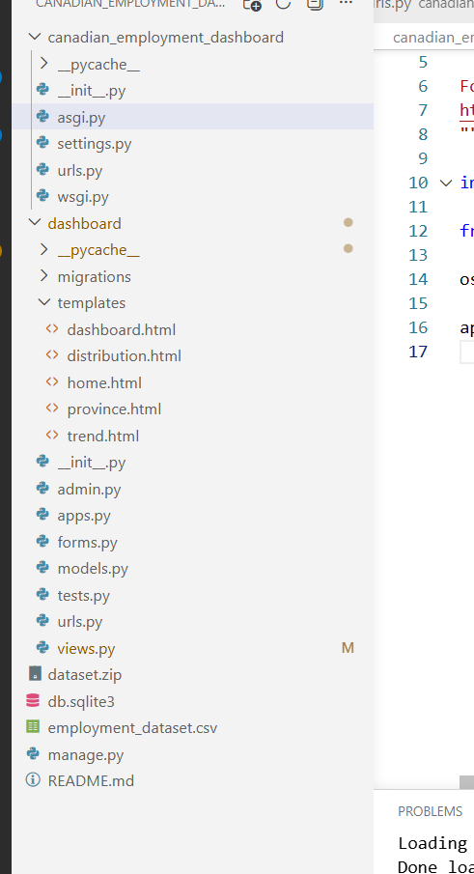
Django Project Structure
• Models → define database structure • Views → handle business logic • Templates → display user interface • Forms → handle file upload • Follows Django MVC architecture • Clean separation of components

Slide 6
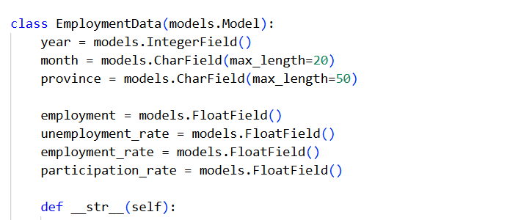
Models and Database
• Model: EmploymentData
• Represents employment dataset
• Fields include:
- Year, Month, Province
- Employment values
- Unemployment rate
• Each object = one database record
• Stored in SQLite database

Slide 7
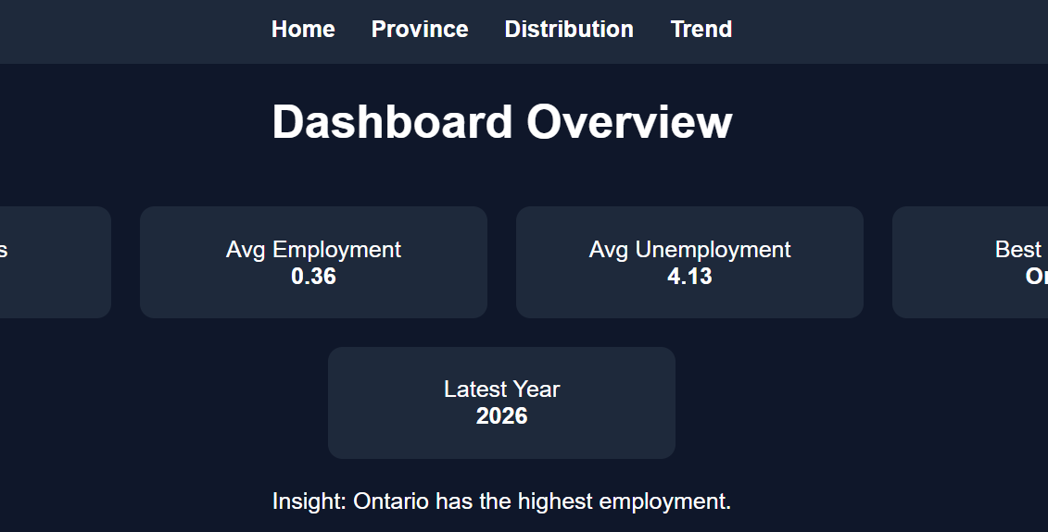
Views and Templates
• Views handle application logic
• Process user requests and data
• Templates display the user interface
• Built using HTML and Django template engine
• Forms handle CSV file upload
• Connect frontend with backend

Slide 8
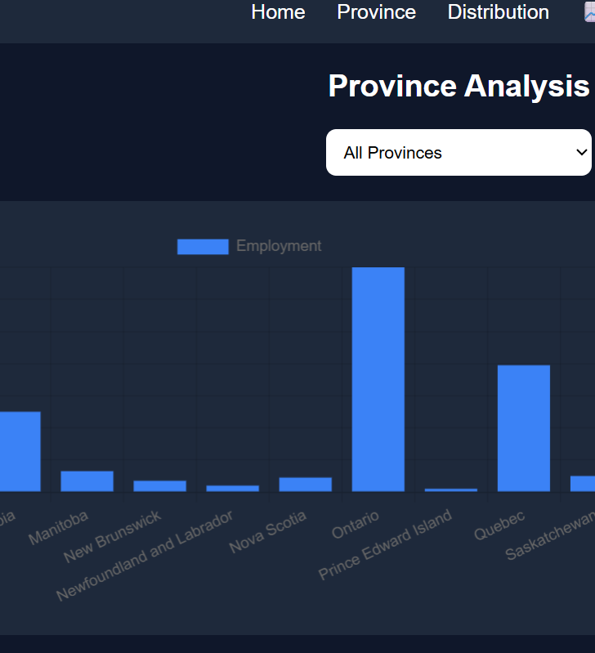
Frontend and Backend
• Frontend:
- User interface (HTML, CSS)
- Displays charts and dashboard
• Backend:
- Django handles logic
- Processes data and database operations
• Charts created using Chart.js
• Connects user input with data visualization

Slide 9
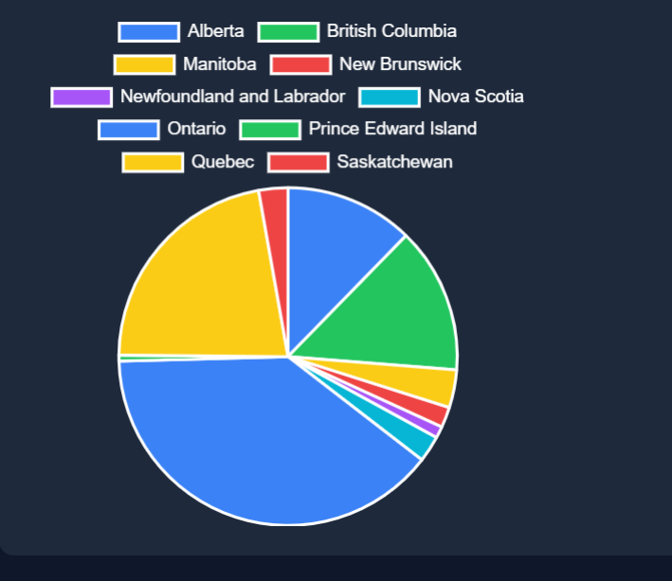
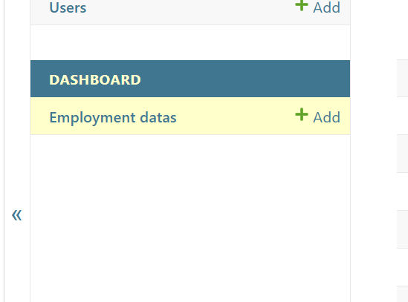
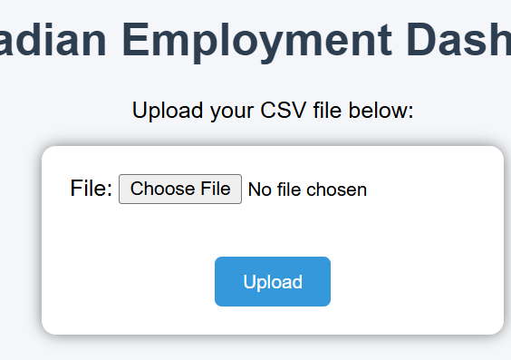
DEMO
Upload CSV dataset • Store data in database • View dashboard with key metrics • Display interactive charts • Filter data by province • Analyze employment trends

Slide 10

Contribution – Nikita
Developed backend logic using Django
Designed database models (EmploymentData)
Implemented data processing and storage
Managed data flow from CSV to database

Slide 11

Contribution – Raman
Designed frontend interface using HTML and CSS
Created templates for dashboard and pages
Improved user experience and layout
Connected frontend with backend views

Slide 12
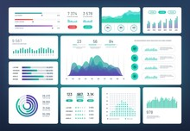
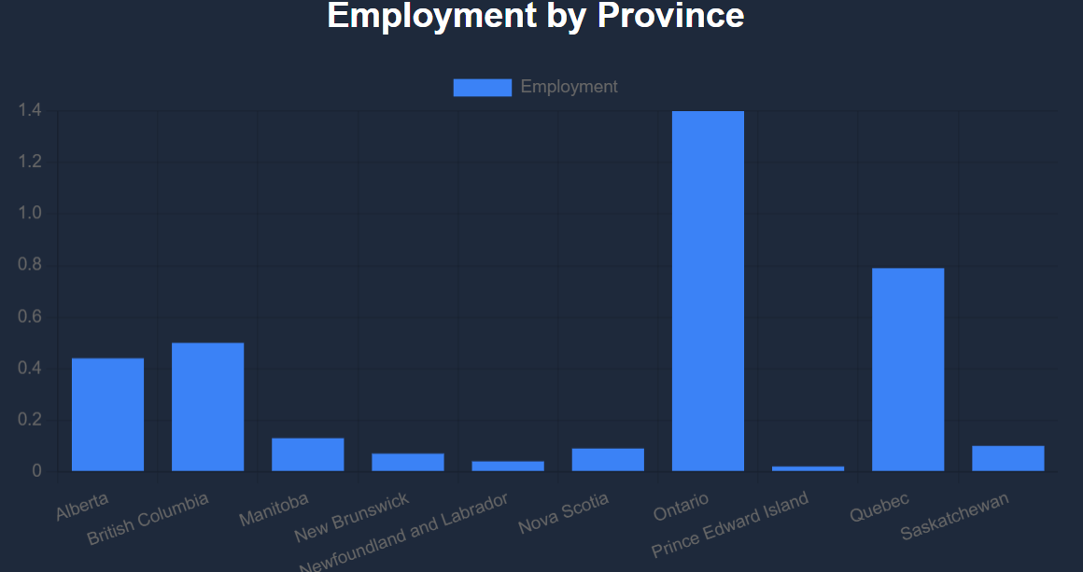
Contribution – Taran
Implemented data visualization using Chart.js
Created charts (bar, pie, line)
Designed trend analysis graphs
Ensured charts display correct data

Slide 13
Conclusion
• Built full Django application
• Used real-world dataset
• Created interactive visualizations

